Slide 1

DealTracker
— Intelligent shopping comparison APP
https://github.com/buChloeCLY/CS501-Project-DealTracker
Team: Leyan Chen, Yijia Chen, Juling Fan

Slide 2
Problem & Introduction
Prices for the same product often vary across platforms, Manual comparison is time-consuming.
Users easily miss limited-time deals.
Existing deal platforms pushes irrelevant discounts to users, lacking personalization.
DealTracker is an intelligent shopping comparison App that bring real-time price comparison, intelligent alerts, and personalized recommendations into one simple mobile experience.
It helps consumers make smarter, faster, and more cost-effective decisions, saving both time and money in an increasingly complex online marketplace.

Slide 3
MVP:
1. Search and Discovery.
Users can search for products by name or category and apply filters to quickly find what they need.
2. Comparison and Analysis.
DealTracker fetches real-time prices from multiple e-commerce platforms, presents results clearly.
3. Tracking and Notification.
DealTracker monitors users’ desired products and notifies them when the product reaches target price.
4. Personalized Recommendations.
DealTracker analyzes user data to recommend products that they may be interested in.
Stretch Goals:
1. Smart Coupon Integration. Automatically collect and recommend discount codes or coupons.
2. Social Sharing. Allow users to directly share transactions on social media.

Slide 4
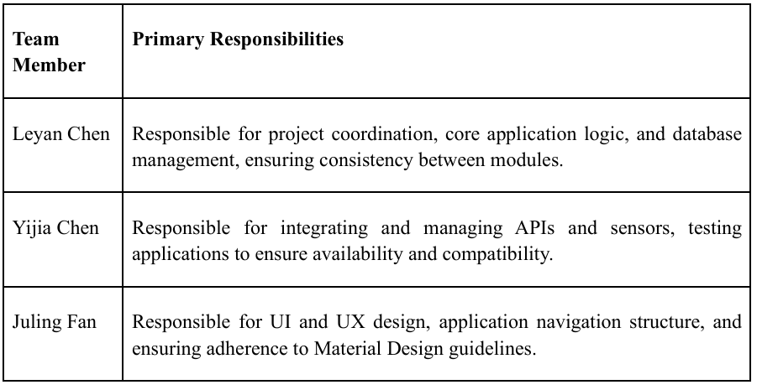
Team Member Responsibilities

Slide 5
APIs and Sensors
A:
Reliable and legitimate data;
Stable and well-documented structure;
High compliance;
Higher integration complexity – Different authentication and rate limits per platform;
Subject to official restrictions – Access may be revoked if terms aren’t followed.
B:
Developer-friendly – Simplified authentication and standardized responses;
Fast prototyping;
Lower data freshness – Price or stock data may lag by minutes or hours;
High costs;
Legal and compliance risks – Some aggregators rely on scraping, which may violate target site terms.
Home Page – Search / Category Browsing / Today’s Deals
Product search and metadata
Option A – Official APIs: Amazon Product Advertising API, Best Buy Developer API, Walmart Developer API
Option B – Aggregator APIs: Rainforest API / SerpAPI / DataForSEO (for multi-platform search results)
Historical low-price / price drop: Maintain our own price history database and update it periodically.
Disability: Microphone for voice search.
Real-Time Cross-Platform Price Comparison
Product details & pricing aggregation: Same as product search;
Tax estimation: Avalara Tax API and GPS.

Slide 6
Price Alerts
Push notifications: Firebase Cloud Messaging (FCM) / OneSignal.
User Profile – Settings / Browsing History
Account / Authentication: Firebase Authentication and OAuth for third-party account login.
Storage: Cloud storage via Firestore; local caching via Room Database.
Comply with relevant privacy regulations like CCPA(California Consumer Privacy Act);
Clearly state what data is collected (e.g., browsing history, location, preferences);
how it is used; Consent Pop-up; Minimize the collected data.

Slide 7
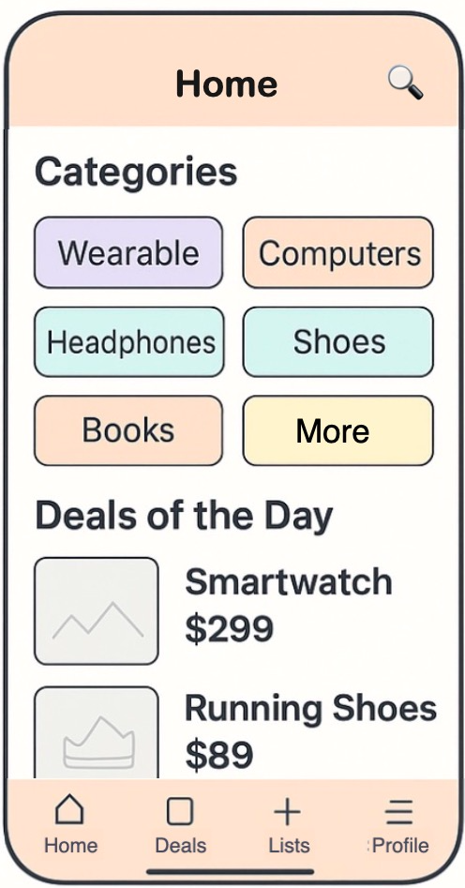
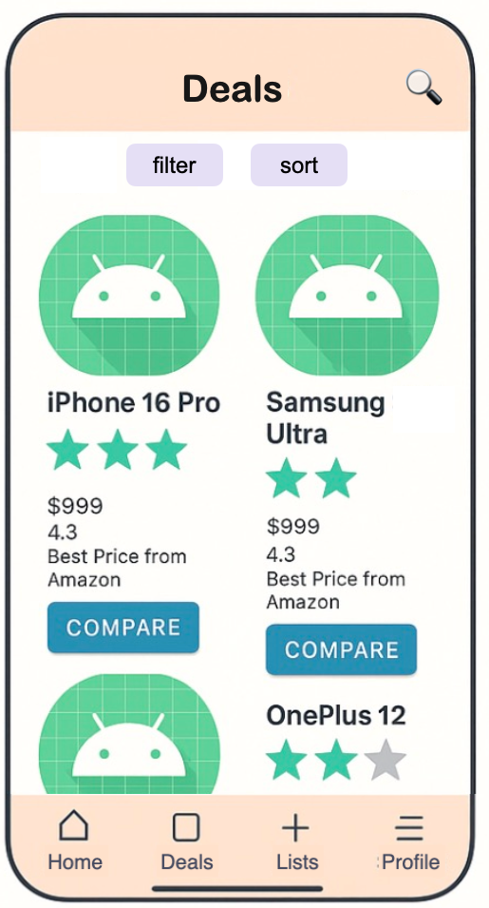
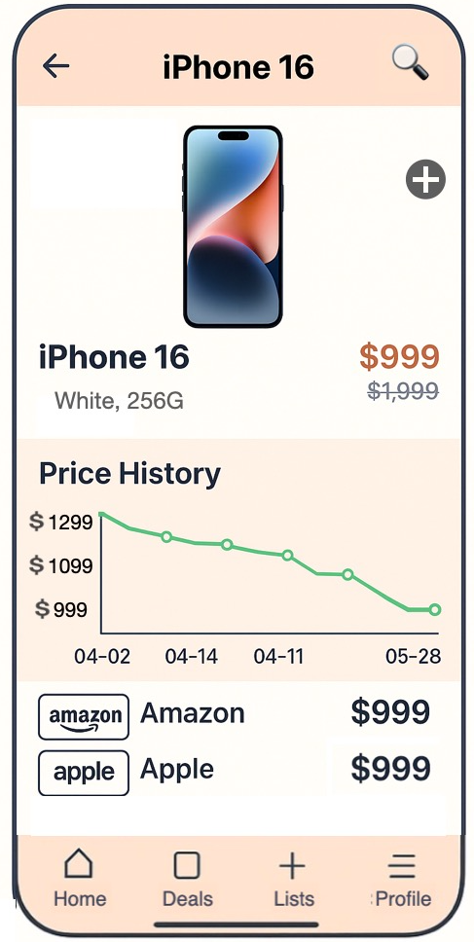
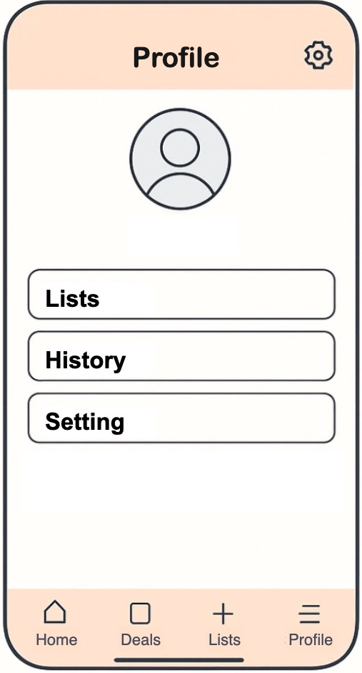
UI/UX Design

Slide 8
Thanks for Listening

